Slide 1

Topic: Condition Variables
Lecture: Dr. Zhao Jie
Date: 04/08/2026

Slide 2
Reading Assignment
Chapters 30

Slide 3
Agenda
Condition variable definition
Parent waiting for child
Bounded buffer between producer and consumer

Slide 4
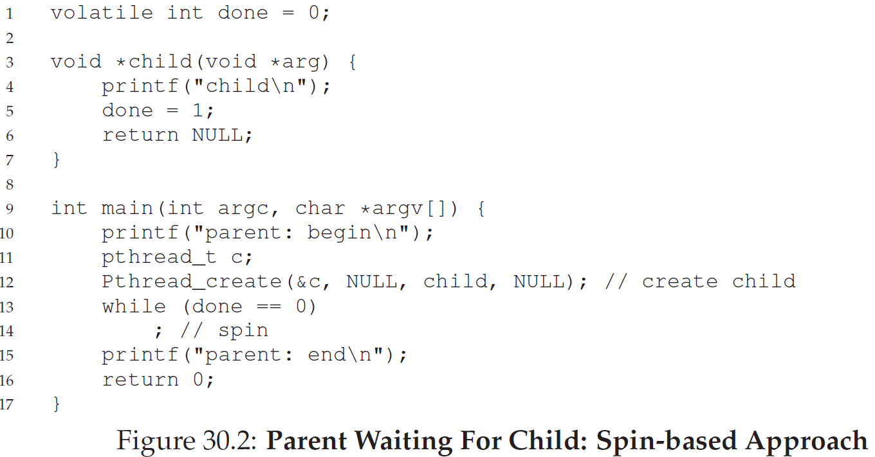
The motivation
Look at the example and try to answer two questions. 1). How does the parent process wait for the child thread? 2). Can we avoid the spin wait?
Notes:
Answer 1: There is a parent process and a child thread. Both could run in parallel. However, when the parent runs in line 12, it will wait until the child thread function is complete, so that the “done” variable is no longer zero. Because if the done is zero, when the parent runs to line 13, it will self-spin.
Answer 2: No.

Slide 5
Definition of condition variable
Motivation
To wait for a condition to become true
Definition
Condition variable is to wait for some expected condition by checking the state of execution
If the expected condition is not ready, the caller must wait.
If ready, the caller will be woken.
Implementation
Wait() – the caller’s self-sleep
Signal() – the caller’s being woken

Slide 6
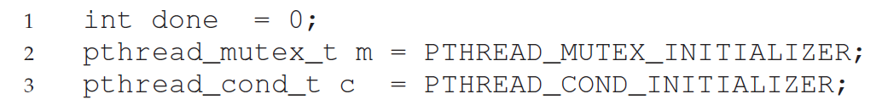
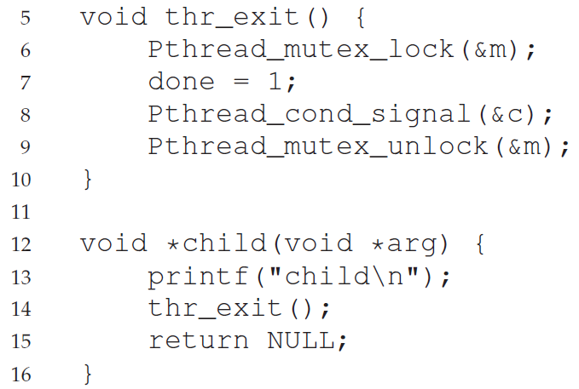
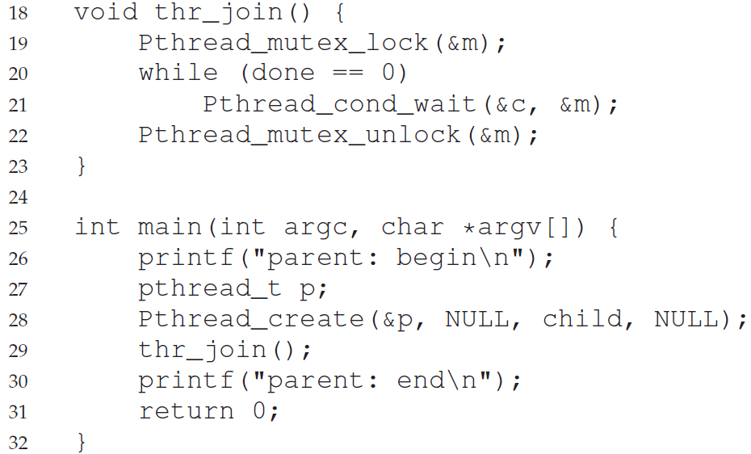
The example of parent waiting for child
Notes:
In the main thread, we create a thread and call the function join() where the function wait() is invoked. In the thread function, exit( ) is induced where another function signal() is triggered.

Slide 7
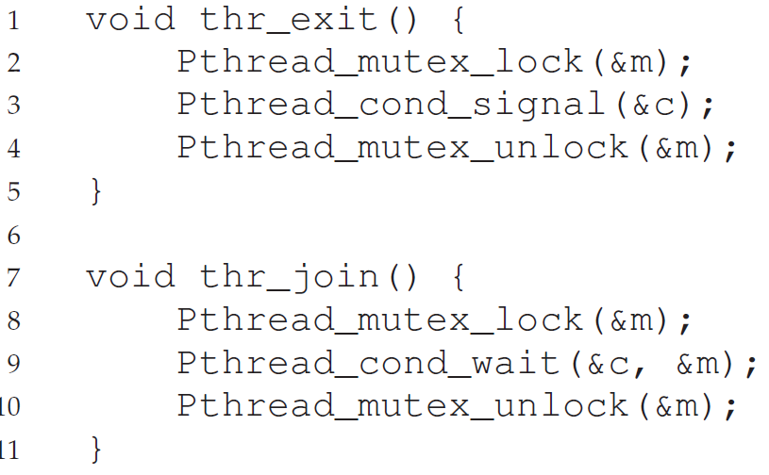
Issues of only using wait() and signal()
Issue analysis: We assume that parent and child threads execute in a synchronized way. When the child thread immediately calls exit( ) where the function signal() is invoked. It is possible that the parent has not yet slept, and thus, the issue is no thread to be woken.

Slide 8
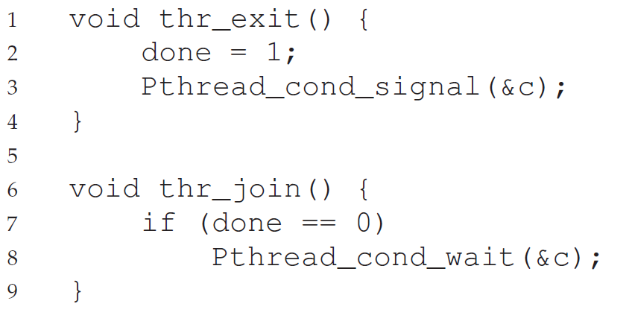
What is the issues raised without the lock?
Notes:
Answer: In the example, without the lock, there must be a race condition when the function join() is invoked. The interruption occurs after the if condition is true but not ready for running the function wait(). The interruption is from the child thread to invoke exit(), where the function signal is induced. However, there will be no thread to be woken.

Slide 9
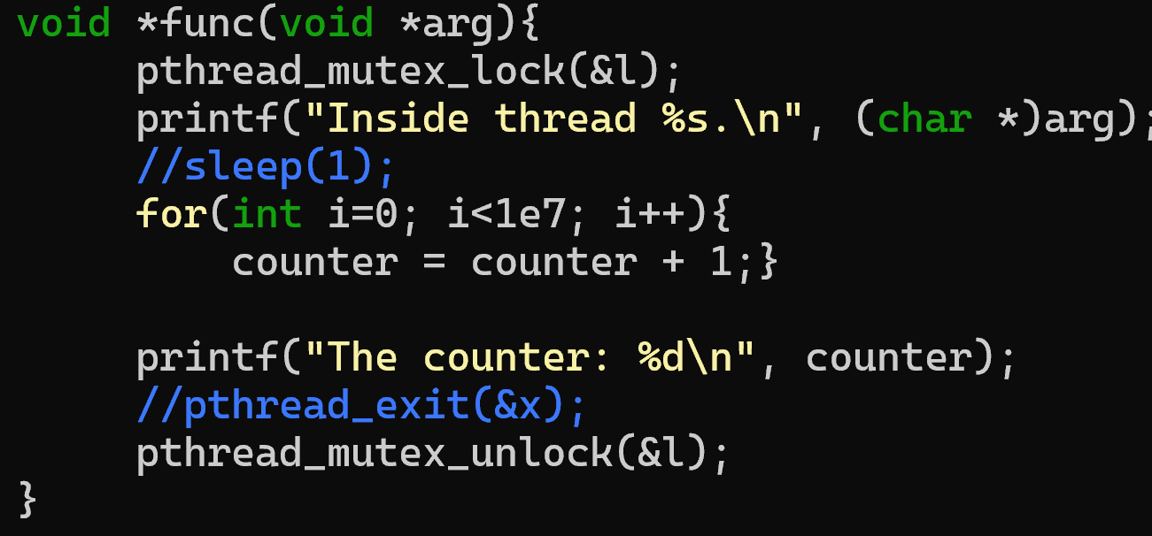
The example of the loop in mutex_lock

Slide 10

Producer and consumer problem - 0
In the manufacturing pipeline, many products, such as apples, are sorted and packaged. How can such an assembly be made more efficient?
A producer is a role that provides the apples from the farm. A consumer is the role that receives raw apples and packages them for production. As you can see, the apple is a shared resource between the producer and consumer. Throughout the assembly of apples, there are two constraints.
C1: If there are no apples, the consumer will wait for the producer to provide them.
C2: If the apple provision is overridden, such as the threshold for maximum production, the producer will wait for the consumer to package the raw apples.

Slide 11
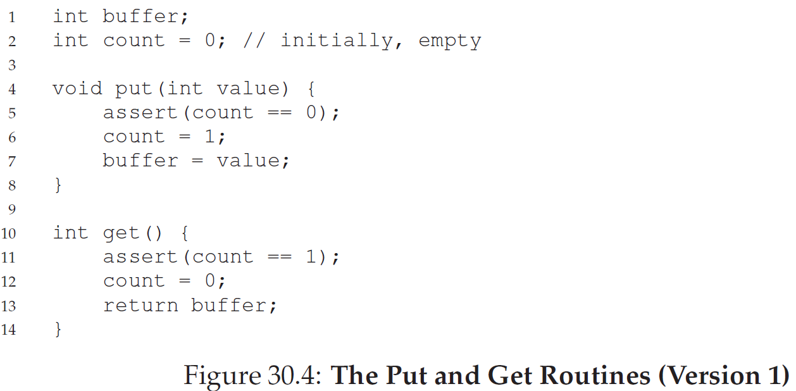
Producer and consumer problem - 1
In the example, there is a bounded buffer.

Slide 12
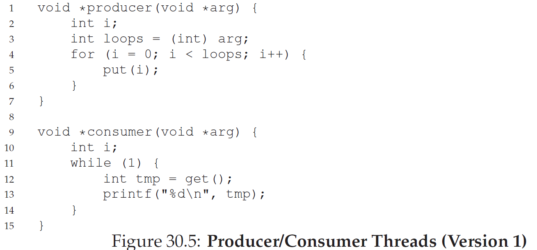
Producer and consumer problem - 2
In the example, we need the lock to put() and get() because they are critical sections.

Slide 13
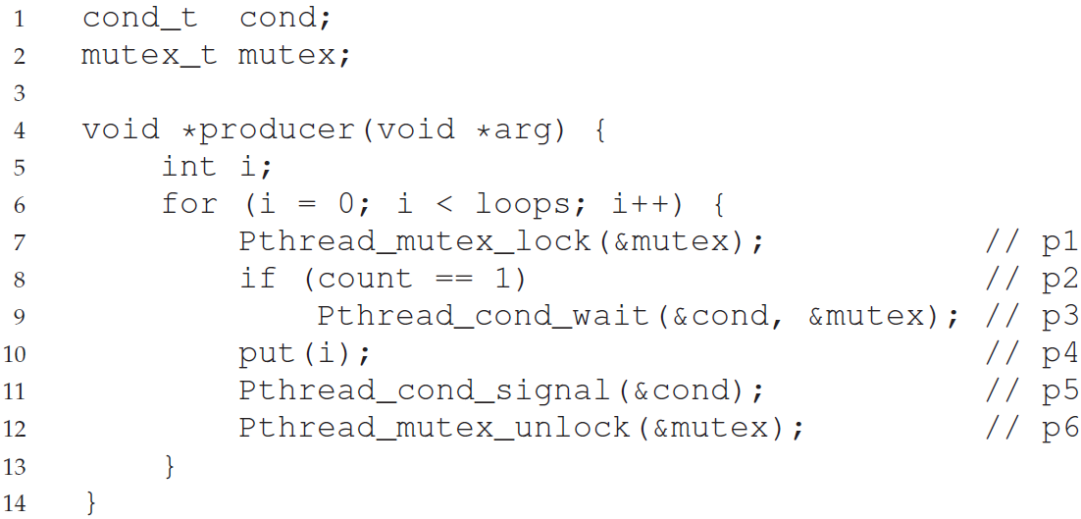
Producer and consumer problem - 3
Q: What does the counter’s value set to 1 mean?
Notes:
Answer: The counter’s value set to 1 means the buffer is full and the producer needs to wait until the consumer consumes the buffer.

Slide 14
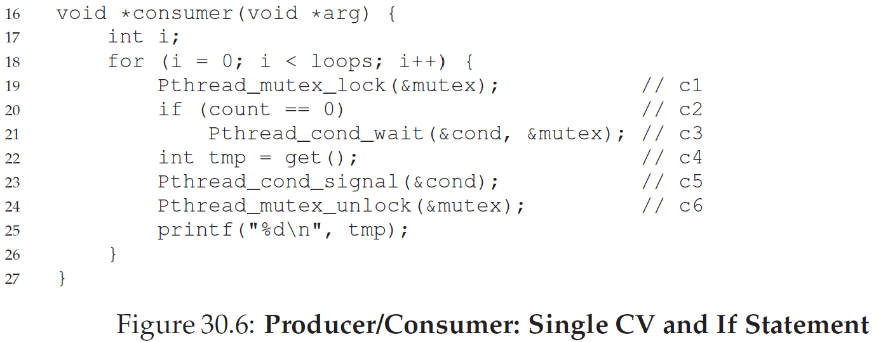
Producer and consumer problem - 4
Q: What does the counter’s value set to 0 mean?
Notes:
Answer: The counter’s value set to 0 means the buffer is empty, and the consumer needs to wait until the producer generates the buffer.

Slide 15
Producer and consumer problem - 5
The issue
There are two consumers and one producer.
When C1 waits for the full buffer, one producer calls put() to satisfy the buffer for only one consumer and then sleeps.
Before C1 gets the buffer, C2 is quicker than C1 getting the buffer, but not wakes the producer. As a result, C1 waits for the buffer, but the producer who makes the buffer full is sleep.
The solution to this issue
On the next page

Slide 16
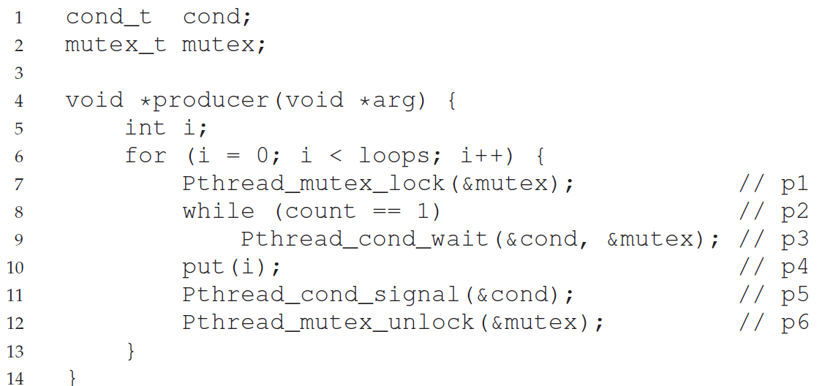
Single CV and while - 1

Slide 17
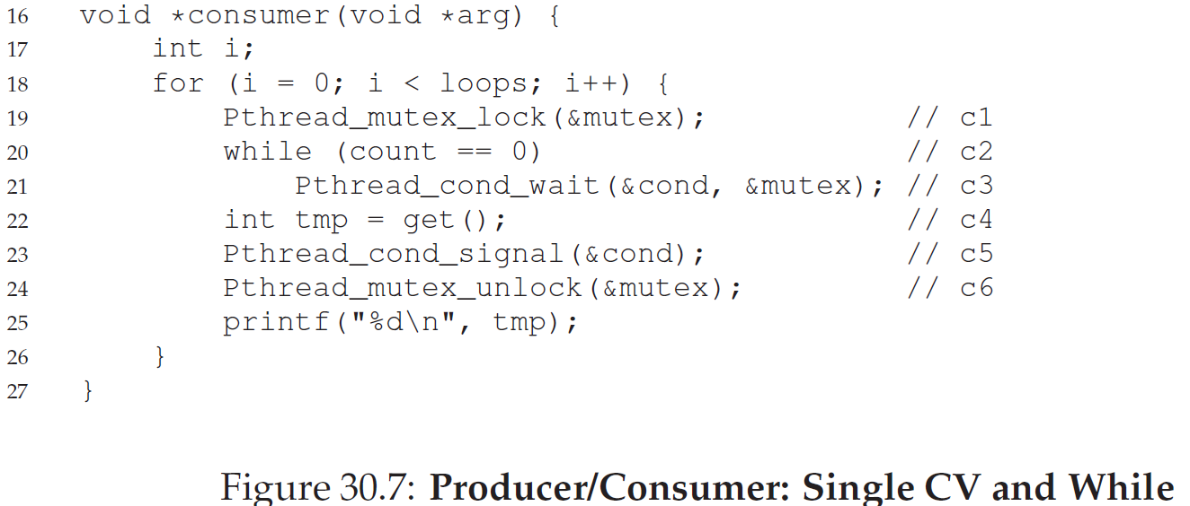
Single CV and while - 2

Slide 18
Issue from single CV
The issue
There are two consumers and one producer.
When C1 and C2 wait for the full buffer, one producer calls put() to satisfy the buffer for only one consumer and then sleeps.
Before C1 gets the buffer, C2 is quicker than C1 getting the buffer, but not wakes the producer. As a result, C1 waits for the buffer, but the producer who makes the buffer full is asleep.

Slide 19
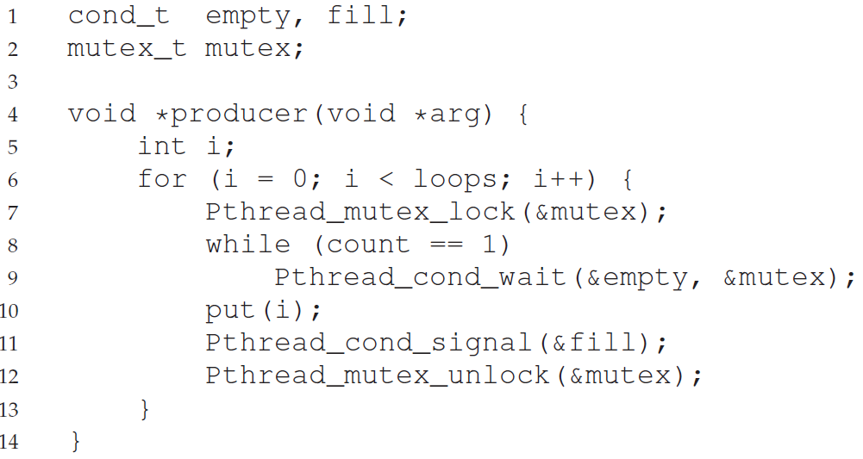
Two CV and while - 1

Slide 20
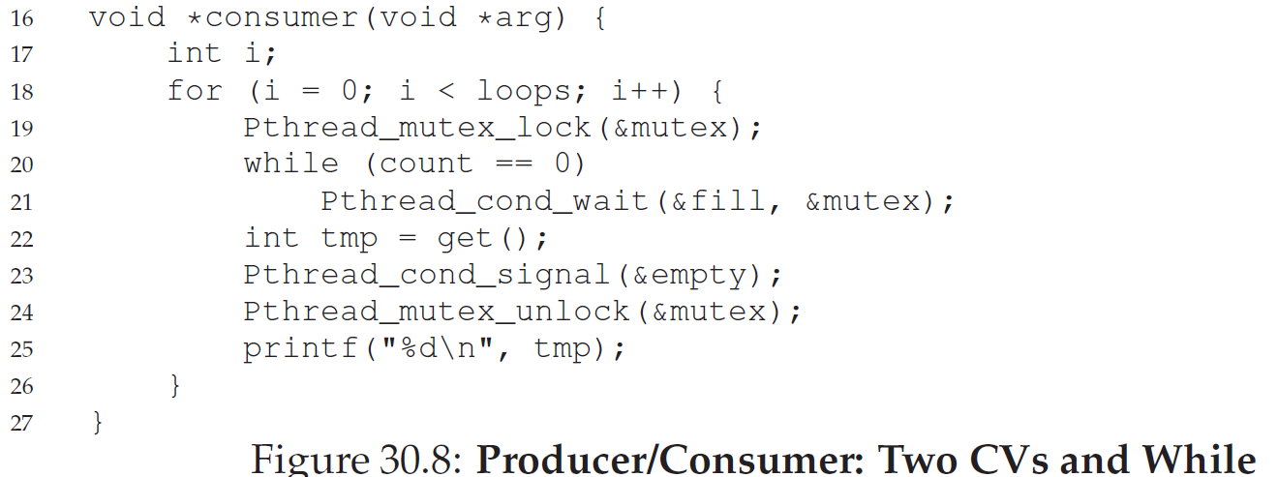
Two CV and while - 2

Slide 21
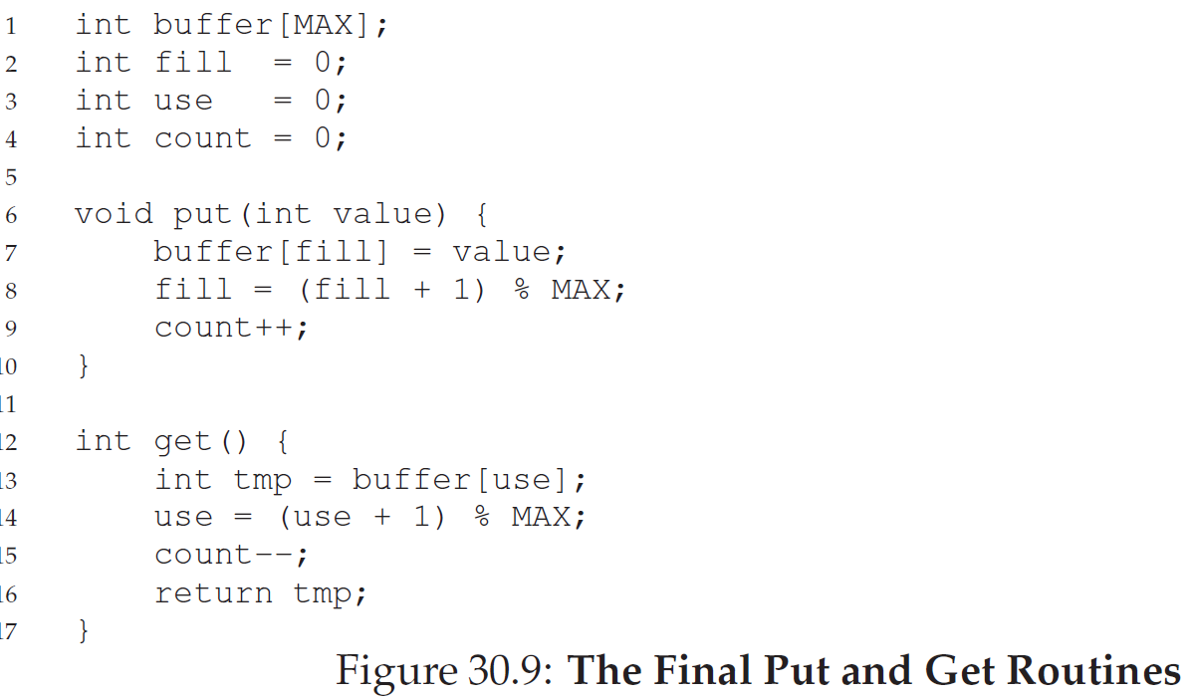
The correct put() and get()

